Slide 1

SEMANTIC NETS & FRAMES

Slide 2
SEMANTIC NETS
Semantic nets are graphical representations used in artificial intelligence and knowledge representation.
Structure: They consist of nodes (concepts or entities) connected by labeled edges (relationships).
Usage: Semantic nets help model and represent knowledge in a structured and visual form.

Slide 3
TYPES OF RELATIONS IN SEMANTIC NETS
Is-A Relation: Indicates a subclass or superclass relationship (e.g., "Car is-a Vehicle").
Part-Of Relation: Shows a whole-part relationship (e.g., "Wheel is part of a Car").
Instance-Of Relation: Connects instances to their respective categories (e.g., "My car is an instance of a Car").

Slide 4
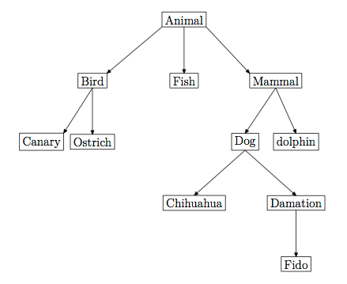
EXAMPLES OF SEMANTIC NETS
EXAMPLE 1 : Representing the Animal Kingdom hierarchy.

Slide 5
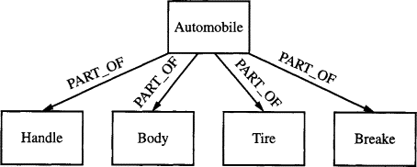
EXAMPLES OF SEMANTIC NETS
EXAMPLE 2 : Representing the Automobile.

Slide 6
ADVANTAGES OF SEMANTIC NETS
Visual Representation: Easy to understand and visualize knowledge.
Modularity: Facilitates the addition or removal of concepts.
Inference: Supports logical reasoning and querying.

Slide 7
DRAWBACKS OF SEMANTIC NETS
Complexity: Can become unwieldy for large knowledge bases.
Ambiguity: Handling complex relationships may lead to ambiguity.
Lack of Context: May not capture contextual information effectively.

Slide 8
FRAMES
Introduction: Frames are a knowledge representation technique, extending semantic nets.
Structure: Frames consist of slots (facets) that store information about an object.
Usage: Frames help represent complex entities and their attributes.

Slide 9
FRAME REPRESENTATION
Slot and Value: Each frame has slots (facets) representing attributes, and each slot has values.
Inheritance: Frames can inherit attributes and values from other frames, allowing for hierarchical organization.
Prototypes: Frames can serve as prototypes for creating new objects.

Slide 10
FACETS IN FRAMES
Facets are the slots in frames that store specific attributes.
Examples:
In a "Car" frame, facets may include "Color," "Model," and "Manufacturer."
Demonstrating a "Person" frame with facets for "Name," "Age," "Occupation," and "Address."

Slide 11
ADVANTAGES OF FRAME REPRESENTATION
Structured Information: Effectively organizes data and attributes.
Inheritance: Supports attribute reuse and simplifies knowledge representation.
Contextual Detail: Allows for rich description of objects and their properties.

Slide 12
DRAWBACKS OF FRAME REPRESENTATION
Complexity: Complex frames can become challenging to manage.
Inefficiency: Inefficient for large-scale knowledge bases.
Knowledge Engineering: Requires significant effort for frame design and maintenance.

Slide 13
THANK
YOU

